Slide 1
Problem Solving Using C
MyAnatomy Integration Pvt. Ltd. (www.myanatomy.in)

Slide 2
My First C Program!
//Program to Print Hello World
#include <stdio.h>
int main()
{
printf (“Hello world!”);
return 0;
}
Output: Hello world!
www.myanatomy.in

Slide 3
C Program Example-1
//Program to print an integer number
#include <stdio.h>
int main()
{
int num = 6;
printf (“The number is = %d”, num);
return 0;
}
Output: The number is = 6
www.myanatomy.in

Slide 4
C Program Example-2
//Program to declare a variable, read the value and print the stored value
#include <stdio.h>
int main()
{
int num;
printf(“Enter an integer number:”);
scanf(“%d”, &num); //Lets enter 6
printf (“The entered number is = %d”, num);
return 0;
}
Output: Enter an integer number: 6
The entered number is = 6
www.myanatomy.in

Slide 5
C Program Example-3
//Program to read two integer from keyboard and print the sum of two integer
#include <stdio.h>
int main()
{
int num1, num2, sum; //Declaration of 2 variables
printf(“Enter two integer numbers:”);
scanf(“%d %d”, &num1, &num2); //Lets enter 3 and 4
sum = num1+num2;
printf (“The sum of two integer is = %d”, sum);
return 0;
}
Output: Enter two integer numbers: 3 4
The sum of two integer is = 7
www.myanatomy.in

Slide 6
Data Types and Input Output
Identifier:
"Identifiers" or "symbols" are the names you supply for variables, types, functions, and labels in your program.
Identifier names must differ in spelling and case from any keywords.
You cannot use keywords as identifiers; they are reserved for special use.
You create an identifier by specifying it in the declaration of a variable, type, or function.
In the example below, num is an identifier for an integer variable, and main and printf are identifier names for functions.
www.myanatomy.in

Slide 7
Data Types and Input Output
Identifier:
#include <stdio.h>
int main()
{
int num=5;
if(num != 0)
printf(“NOT ZERO\n");
}
Once declared, you can use the identifier in later program statements to refer to the associated value.
www.myanatomy.in

Slide 8
Data Types and Input Output
Variable:
A variable is nothing but a memory area used to store data.
Each variable must be represented with a unique name. For example, int no = 2;
Here, no is the name of the variable which contains the integer value 2.
The value stored can be changed, hence it is called variable.
Each variable is associated with an address.
int no = 5;
5
100
no
In the above declaration, int is the data type, no is the variable name, 5 is the value stored at no, and 100 is the address of the memory location.
www.myanatomy.in

Slide 9
Data Types and Input Output
Data Types:
A data type defines the type of values a variable can store. In C programming, every variable is associated with a data type.
Each data type requires different amount of memory.
For example; a variable declared as integer can store only integer values.
In C, data types are categorized into three groups; primitive, user defined and derived type.
Void data type has no value or operator and it does not provide a result to its caller. But void comes under Primitive data types.
www.myanatomy.in

Slide 10
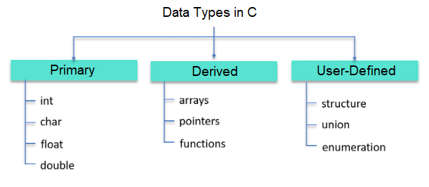
Data Types and Input Output
Data Types:
www.myanatomy.in

Slide 11
Data Types and Input Output
Primary Data Types:
Primary data types are also known as the fundamental data types because they are pre-defined or they already exist in the C language.
All the other types of data types (derived and user-defined data types) are derived from these data types. Primary data types in C are of 4 types: int, char, float, and double.
Data Type | Memory(bytes) | Range | Format Specifier
int | 2 or 4 | -2,147,483,648 to 2,147,483,647 | %d
char | 1 | -128 to 127 | %c
float | 4 | 1.2E-38 to 3.4E+38 | %f
double | 8 | 1.7E-308 to 1.7E+308 | %lf
www.myanatomy.in

Slide 12
Data Types and Input Output
Primary Data Types:
The int data type is used to store the integer values.
Syntax: int variable_name; Example: int num;
The char data type is used to store the characters.
Syntax: char variable_name; Example: char x;
The float data type is used to store the floating-point numbers. The numbers that have a fractional part are called floating-point numbers. For example, 5.0, 5.7, -23.2, -4.12, etc. are all floating-point numbers.
Syntax: float varaible_name; Example: float radius = 10.0;
The double data type is also used to store floating-point numbers. But still, it is considered as a distinct data type because of two reasons.
-The first one is that it occupies twice as much memory as type float.
-The second reason is that it is used to store a much larger range of floating-point numbers than a float data type.
Syntax: double variable_name; Example: double area, volume;
www.myanatomy.in

Slide 13
Data Types and Input Output
Derived Data Types:
Derived data types are derived from the primitive or fundamental data types. There are mainly 3 types of derived data types in C.
Derived Data Types: Array
An array is a group of similar kinds of finite entities of the same type. These entities or elements can be referred to by their indices respectively. The indexing starts from 0 to (array_size-1) conventionally. An array can be one-dimensional, two-dimensional, or multidimensional.
Syntax: data_type array_name[size]; Example: int my_array[5];
In the above example, int is the data type, my_array is the name of the array and 5 is the size of the array.
my_array
0 1 2 3 4
www.myanatomy.in

Slide 14
Data Types and Input Output
www.myanatomy.in

Slide 15
Data Types and Input Output
//Program to read two integer from keyboard and print the sum of two integer
#include <stdio.h>
int main()
{
int num1, num2, sum; //Declaration of 2 variables
printf(“Enter two integer numbers:”);
scanf(“%d %d”, &num1, &num2); //Lets enter 3 and 4
sum = num1+num2;
printf (“The sum of two integer is = %d”, sum);
return 0;
}
Output: Enter two integer numbers: 3 4
The sum of two integer is = 7
www.myanatomy.in

Slide 16
Expressions and Operators
These are two types of Arithmetic Operators in C.
Binary
Unary
Binary Arithmetic Operators
This type of operator operates on two of the operands.
A typical binary operator appears in this format with its operands:
operand1 operator operand2
Operator | Description | Example
– | Subtraction of the second variable from the first one | var = X – Y = -5
+ | Addition of two operands | var = X + Y = 15
/ | Division of the numerator by the de-numerator | var = Y / X = 2
* | Multiplication of both the operands | var = X * Y = 50
% | The modulus operator and the remainder after the division of an integer | var = Y % X = 0

Slide 17
Expressions and Operators
Unary Arithmetic Operators
This type of operator operates only on one operand.
A typical unary operator appears in the following format with its operand:
operator operand
Operator | Description | Example
-- | Decrease of the integer value by the decrement operator by one | var = X--
++ | Increase of the integer value by the increment operator by one | var = X++
- | Unary minus | var = -X
+ | Unary plus | var = +X

Slide 18
Expressions and Operators
Relational and Logical Operators
#include <stdio.h>
int main()
{
int x = 10;
int y = 28;
if(x==y)
printf("Both variables are equal");
if(x>y)
printf("x is greater than y");
if(x<y)
printf("x is less than y");
if(x!=y)
printf("x is not equal to y ");
if(x<=y)
printf("x is lesser or equal to y");
if(x>=y)
printf("x is greater or equal to y ");
return 0;
}
Relational operators are used to compare two values in C language. It checks the relationship between two values. If relation is true, it returns 1. However, if the relation is false, it returns 0.
Here is the table of relational operators in C language:
Operators | Operator Name
== | Equal to
> | Greater than
< | Less than
!= | Not equal to
>= | Greater than or equal to
<= | Less than or equal to
Output:
x is less than y
x is not equal to y
x is lesser or equal to y

Slide 19
Expressions and Operators
Relational and Logical Operators
#include <stdio.h>
int main()
{
int x = 10;
int y = 28;
int a = 15;
int b = 20;
if(x<y && a==b)
printf("x is less than y AND a is equal to b");
if(x<y || a==b)
printf("x is less than y OR a is equal to b");
if(!x)
printf("x is zero");
return 0;
}
Logical operators are used to perform logical operations. It returns 0 or 1 based on the result of condition, whether its true or false. These operators are used for decision making in C language.
Here is the table of logical operators in C language,
Operators | Meaning of Operators | Results
&& | Logical AND | True when all operands are true
|| | Logical OR | True only if either one operand is true
! | Logical NOT | True when operand is zero
Output:
x is less than y OR a is equal to b

Slide 20
Expressions and Operators
Precedence and Associativity of operators
Operator precedence determines which operation is performed first in an expression with more than one operators with different precedence.
For example: Solve 10 + 20 * 30
10 + 20 * 30 is calculated as 10 + (20 * 30) and not as (10 + 20) * 30
Operators Associativity is used when two operators of same precedence appear in an expression. Associativity can be either Left to Right or Right to Left.
For example: ‘*’ and ‘/’ have same precedence and their associativity is Left to Right
So the expression “100 / 10 * 10” is treated as “(100 / 10) * 10”.
Operators Precedence and Associativity are two characteristics of operators that determine the evaluation order of sub-expressions in absence of brackets
For example: Solve
100 + 200 / 10 - 3 * 10

Slide 21
Expressions and Operators
Precedence and Associativity of operators
Associativity is only used when there are two or more operators of same precedence.
The point to note is associativity doesn’t define the order in which operands of a single operator are evaluated.
All operators with the same precedence have same associativity
This is necessary, otherwise, there won’t be any way for the compiler to decide evaluation order of expressions which have two operators of same precedence and different associativity. For example + and – have the same associativity.
Precedence and associativity of postfix ++ and prefix ++ are different.
Precedence of postfix ++ is more than prefix ++, their associativity is also different. Associativity of postfix ++ is left to right and associativity of prefix ++ is right to left.
Comma has the least precedence among all operators and should be used carefully
There is no chaining of comparison operators in C
In Python, expression like “c > b > a” is treated as “c > b and b > a”, but this type of chaining doesn’t happen in C.

Slide 22
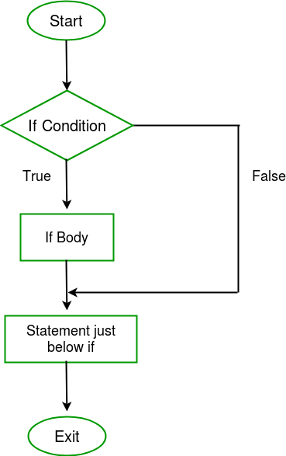
If Statement
if - statement:
C program to illustrate If statement
Syntax :
if(condition)
{
// Statements to execute if.
// condition is true.
}
//remaining statements
//remaining code
#include<stdio.h>
int main()
{
int i = 20;
if (i > 10)
{
printf("10 is less than 10“};
}
printf(“Out side if block“);
}
www.myanatomy.in

Slide 23
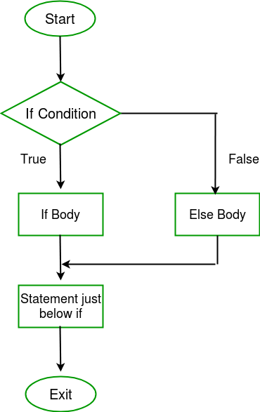
If Statement
if-else statement:
C program to illustrate If-else statement
Syntax :
if(condition)
{
// Statements to execute if.
// condition is true.
}
else
{
//Execute this code
}
//remaining statements
//remaining code
#include<stdio.h>
int main()
{
int i = 20;
if (i > 10)
{
printf(“20 is greater than 10“);
}
else
{
printf( “20 is less than 10”);
}
return 0;
}
www.myanatomy.in

Slide 24
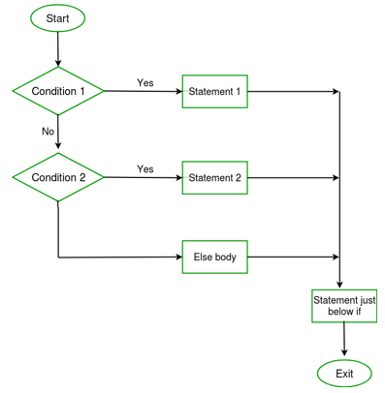
If Statement
if-else-if statement:
C program to illustrate If-else-if statement
Syntax :
if(condition)
{
// This statement;
}
else if(condition)
{
//Execute this code;
}
else
//this statement;
//remaining code
#include<stdio.h>
int main()
{
int i = 50;
if (i == 10)
printf("i is 10“);
else if (i == 15)
printf("i is 15“);
else if (i == 20)
printf("i is 20“);
else
printf("i is not present“);
}
www.myanatomy.in

Slide 25
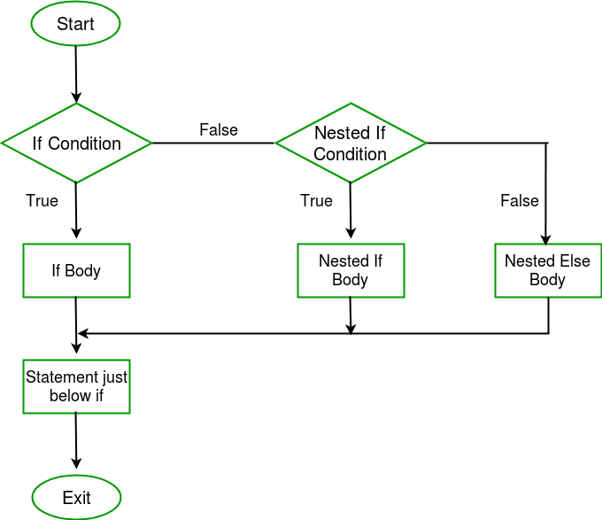
If Statement
nested-if statement:
Syntax :
if (condition1)
{
// Executes this
if (condition2)
{
// Executes this
}
}
www.myanatomy.in

Slide 26
If Statement
nested-if statement:
#include <stdio.h>
int main()
{
int i = 20;
if (i <100)
{
if (i < 15)
printf(“i is smaller than 15\n”);
if (i < 12)
printf(“i is smaller than 12 too\n”);
else
printf(“i is greater than 15”);
}
return 0;
}
C program to illustrate nested-if statement
www.myanatomy.in

Slide 27
Conditional 0perators and Switch Statement
Conditional Operator:
The conditional operator is also known as a ternary operator. The conditional statements are the decision-making statements which depends upon the output of the expression. It is represented by two symbols, i.e., '?' and ':'.
As conditional operator works on three operands, so it is also known as the ternary operator.
The behavior of the conditional operator is similar to the 'if-else' statement as 'if-else' statement is also a decision-making statement.
Syntax of a conditional operator
expression1? expression2: expression3;
Meaning of the above syntax.
In the above syntax, the expression1 is a Boolean condition that can be either true or false value.
If the expression1 results into a true value, then the expression2 will execute.
The expression2 is said to be true only when it returns a non-zero value.
If the expression1 returns false value then the expression3 will execute.
The expression3 is said to be false only when it returns zero value.
www.myanatomy.in

Slide 28
Conditional 0perators and Switch Statement
Conditional Operator Example:
#include <stdio.h>
int main()
{
int age; // variable declaration
printf("Enter your age");
scanf("%d",&age); // taking user input for age variable
(age>=18)? (printf("eligible for voting")) : (printf("not eligible for voting")); // conditional operator
return 0;
}
Output:
Enter your age 12
not eligible for voting
www.myanatomy.in

Slide 29
Conditional 0perators and Switch Statement
Switch Statement:
The switch statement in C is an alternate to if-else-if ladder statement which allows us to execute multiple operations for the different possible values of a single variable called switch variable. Here, We can define various statements in the multiple cases for the different values of a single variable.
The syntax of switch statement in c language is given below:
switch(expression){
case value1:
//code to be executed;
break; //optional
case value2:
//code to be executed;
break; //optional
......
default:
code to be executed if all cases are not matched;
}
www.myanatomy.in

Slide 30
Conditional 0perators and Switch Statement
Switch Statement:
Rules for switch statement in C language
The switch expression must be of an integer or character type.
The case value must be an integer or character constant.
The case value can be used only inside the switch statement.
The break statement in switch case is not must. It is optional. If there is no break statement found in the case, all the cases will be executed present after the matched case. It is known as fall through the state of C switch statement.
www.myanatomy.in

Slide 31
Conditional 0perators and Switch Statement
Switch Statement:
#include<stdio.h>
int main(){
int number=0;
printf("enter a number:");
scanf("%d",&number);
switch(number){
case 10:
printf("number is equals to 10");
break;
case 50:
printf("number is equal to 50");
break;
case 100:
printf("number is equal to 100");
break;
default:
printf("number is not equal to 10, 50 or 100");
}
return 0;
}
Output
enter a number:4
number is not equal to 10, 50 or 100
enter a number:50
number is equal to 50
www.myanatomy.in

Slide 32
Loop Control Structure
In programming, sometimes we need to execute a block of code multiple times.
Loops come into use when we need to repeatedly execute a block of statements.
Loops are handy because they save time, reduce errors, and they make code more readable.
There are three types of loop in C; for, while, and do-while.
for loop is used when we know exactly how many times a block of code need to be executed.
while loop execute a block of code as long as a specified condition is satisfied.
while loop is used when you don’t know exactly how many times the block of code needs to be executed.
The do-while loop is a variant of the while loop. This loop will execute the code block once, before checking if the condition is true, then it will repeat the loop as long as the condition is true.
www.myanatomy.in

Slide 33
Loop Control Structure
for loop:
Syntax:
for (statement 1; statement 2; statement 3)
{
// code block to be executed;
}
Statement 1 is executed (one time) before the execution of the code block. It is an initialization statement.
Statement 2 defines the condition for executing the code block. It is a conditional statement.
Statement 3 is executed (every time) after the code block has been executed. It is a updating statement.
www.myanatomy.in

Slide 34
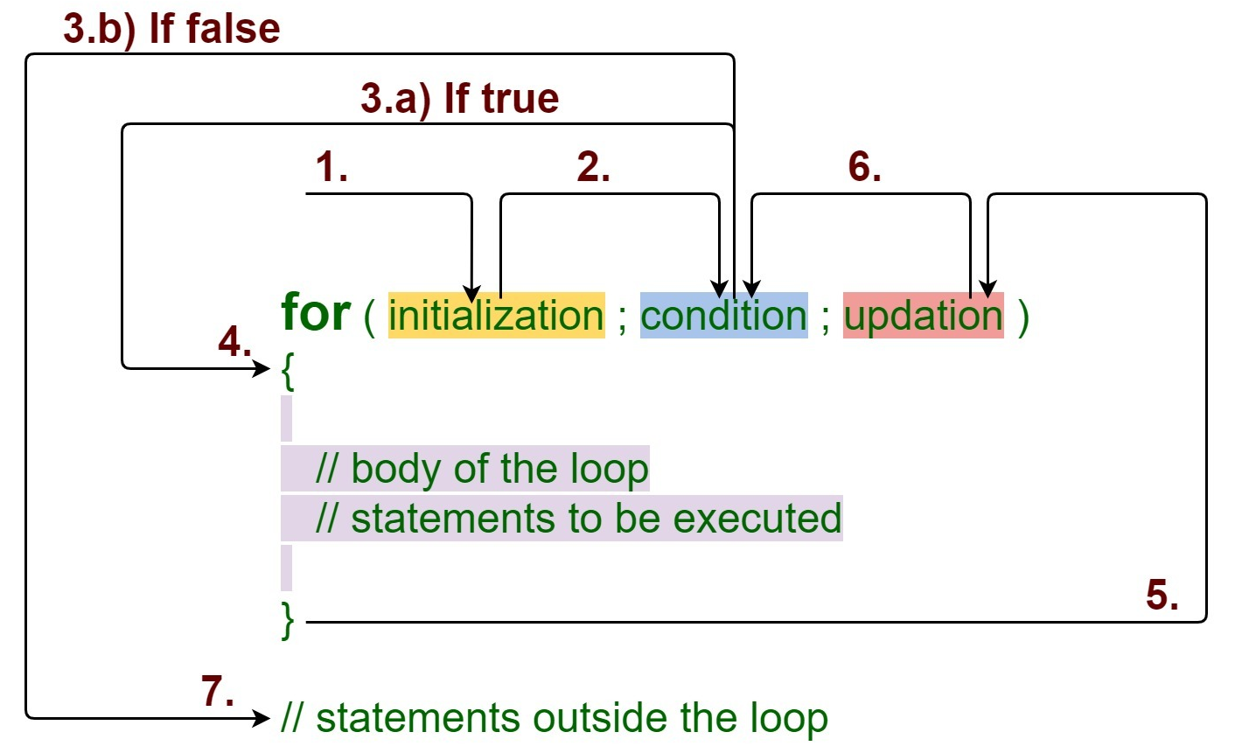
Loop Control Structure
for loop:
www.myanatomy.in

Slide 35
Loop Control Structure
for loop example:
Write a C program to display MyAnatomy five times?
Output: MyAnatomy
MyAnatomy
MyAnatomy
MyAnatomy
MyAnatomy
#include <stdio.h>
int main()
{
int i, n=5;
for (i = 0; i < n; i++)
{
printf(“MyAnatomy”);
}
return 0;
}
Q. Write a C program to display only even numbers between 0 and 100?
www.myanatomy.in

Slide 36
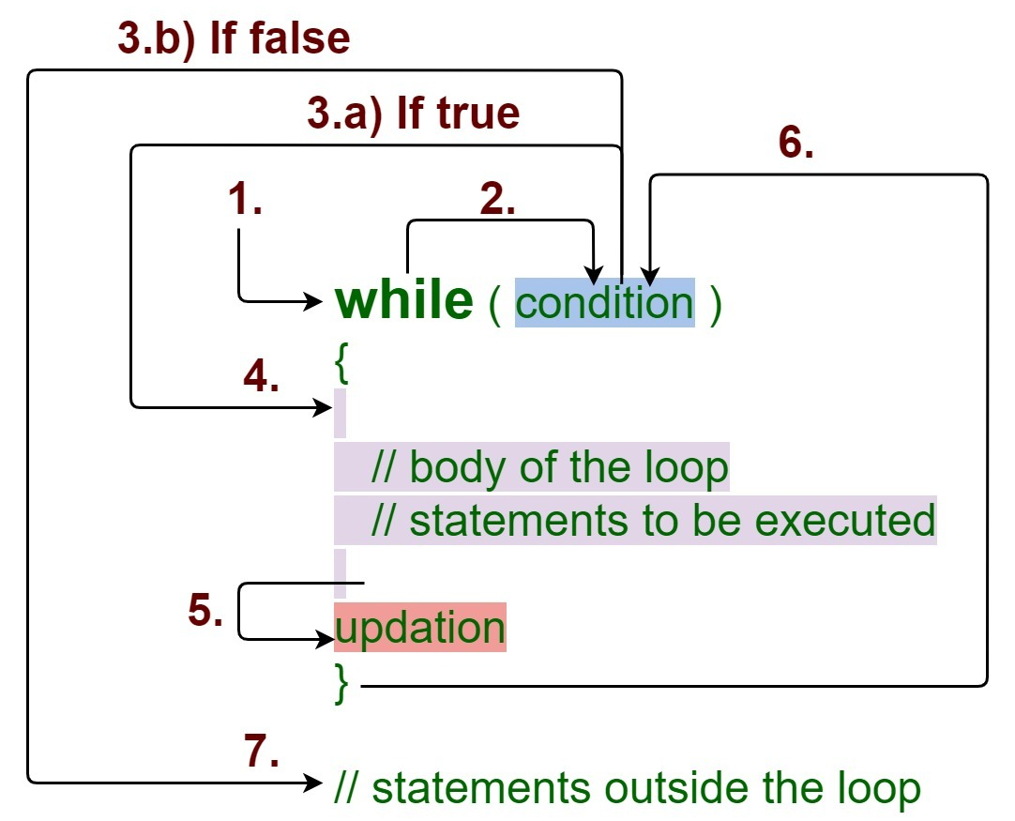
Loop Control Structure
while loop:
The while loop loops through a block of code as long as a specified condition is true.
Syntax:
while (condition)
{
// code block to be executed
}
www.myanatomy.in

Slide 37
Loop Control Structure
while loop example-1:
// C program to illustrate while loop
#include <stdio.h>
int main( )
{
int i = 1;
while (i < 5)
{
printf(“MyAnatomy “);
i++;
}
return 0;
}
Output: MyAnatomy
MyAnatomy
MyAnatomy
MyAnatomy
www.myanatomy.in

Slide 38
Loop Control Structure
while loop example-2:
// C Program to display even numbers from 10 to 20
#include <stdio.h>
int main()
{
int i = 10;
while (i <= 20)
{
printf(“%d”,i);
i+=2;
}
return 0;
}
Output: 10 12 14 16 18 20
www.myanatomy.in

Slide 39
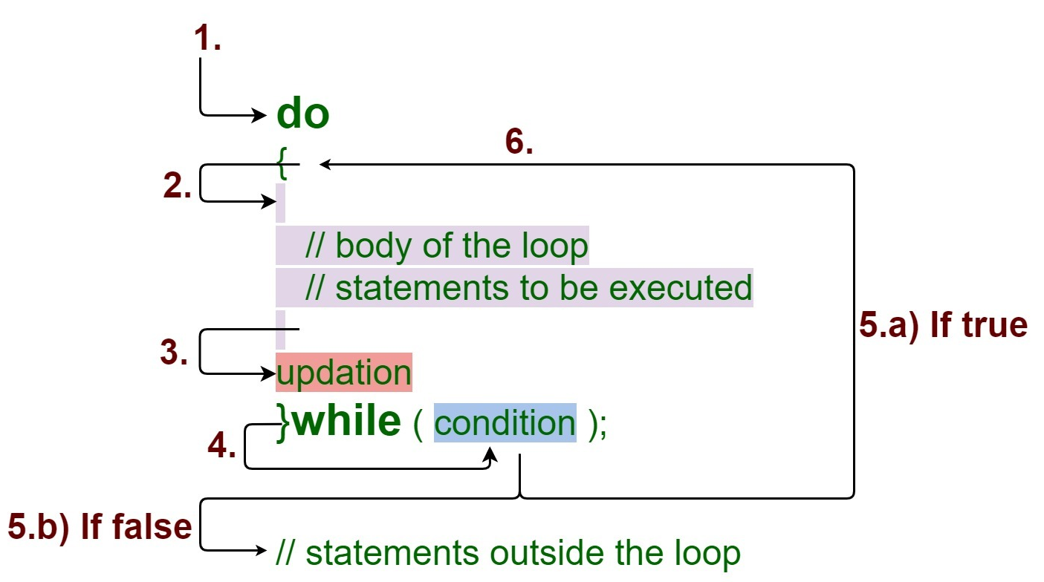
Loop Control Structure
do-while loops:
The do-while loop is a variant of the while loop. This loop will execute the code block once, before checking if the condition is true, then it will repeat the loop as long as the condition is true.
Syntax:
do
{
// code block to be executed
}
while (condition)
www.myanatomy.in

Slide 40
Loop Control Structure
do-while loop example-1:
#include <stdio.h>
int main( )
{
int i = 0;
do{
printf( “MyAnatomy” );
i++;
}
while (i < 3);
return 0;
}
Output: MyAnatomy
MyAnatomy
MyAnatomy
www.myanatomy.in

Slide 41
Loop Control Structure
www.myanatomy.in

Slide 42
Fuctions
A function is a block of code which only runs when it is called. You can pass data, known as parameters, into a function. Functions are used to perform certain actions, and they are important for reusing code: Define the code once, and use it many times.
Function Declaration and Definition:
A function consist of two parts:
Declaration: the function's name, return type, and parameters (if any)
Definition: the body of the function (code to be executed)
void myFunction()// declaration
{ // the body of the function (definition) }
www.myanatomy.in

Slide 43
Fuctions
For code optimization, it is recommended to separate the declaration and the definition of the function.
You will often see C programs that have function declaration above main(), and function definition below main(). This will make the code better organized and easier to read:
Example:
#include<stdio.h> void myFunction(); // Function declaration int main() // The main method
{ myFunction(); // call the function return 0; } void myFunction() // Function definition
{ printf(“This is MKP"); }
www.myanatomy.in

Slide 44
Fuctions
Function Scope:
A Function scope begins at the opening of the function and ends with the closing of it. Function scope is applicable to labels only. A label declared is used as a target to go to the statement and both goto and label statement must be in the same function.
void func1()
{
{
// label in scope even
// though declared later
goto label_exec;
label_exec:;
}
// label ignores block scope
goto label_exec;
}
void funct2()
{
// throwserror:
// as label is in func1() not funct2()
goto label_exec;
}
www.myanatomy.in

Slide 45
Fuctions
Function Scope:
Now various questions may arise with respect to the scope of access of variables:
What if the inner block itself has one variable with the same name? If an inner block declares a variable with the same name as the variable declared by the outer block, then the visibility of the outer block variable ends at the point of the declaration by inner block.
What about functions and parameters passed to functions? A function itself is a block. Parameters and other local variables of a function follow the same block scope rules.
Can variables of the block be accessed in another subsequent block? No, a variable declared in a block can only be accessed inside the block and all inner blocks of this block.
www.myanatomy.in

Slide 46
Storage Classes in C
The storage classes define the visibility (scope) and the lifetime of any function/ variable within a C program. These classes precede the type that they are going to modify.
Types of Storage Classes in C:
There are four different types of storage classes that we use in the C language:
Automatic Storage Class
External Storage Class
Static Storage Class
Register Storage Class
A variable given in a C program will have two of the properties: storage class and type. Here, type refers to any given variable’s data type, while the storage class determines that very variable’s lifetime, visibility, and also its scope.
www.myanatomy.in

Slide 47
Storage Classes in C
Summary of Storage Classes in C
Class | Name of Class | Place of Storage | Scope | Default Value | Lifetime
auto | Automatic | RAM | Local | Garbage Value | Within a function
extern | External | RAM | Global | Zero | Till the main program ends. One can declare it anywhere in a program.
static | Static | RAM | Local | Zero | Till the main program ends. It retains the available value between various function calls.
register | Register | Register | Local | Garbage Value | Within the function
www.myanatomy.in

Slide 48
Pointers in C
In C, pointers are variables that store the memory addresses of other variables.
If we have a variable var in our program, &var will give us its address in the memory.
The unary operator & is used to access the address of a variable. It is called address operator or reference operator.
The unary operator * is used for declaring a pointer variable and to access the value stored in a address. It is called value operator, dereference operator, or indirection operator.
www.myanatomy.in

Slide 49
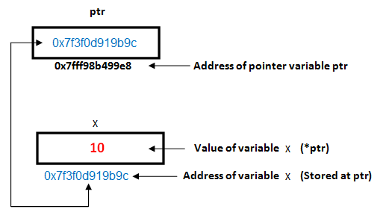
Pointers in C
Program to demonstrate pointer:
#include <stdio.h>
int main()
{
int x = 10;
int *ptr = &x;
printf("Value of x = %d”, *ptr);
printf("Address of x = %p”, ptr);
*ptr = 20;
printf("After doing *ptr = 20, *ptr is %d”, *ptr);
return 0;
}
Output:
Value of x = 10
Address of x = 0x7f3f0d919b9c
After doing *ptr = 20, *ptr is 20
www.myanatomy.in

Slide 50
Pointers in C
Pointer Assignment:
#include <stdio.h>
int main()
{
int i=25, j=30;
int *p, *q;
p = &i;
q = p;
printf(“%d %d %d %d”, i, j, *p,*q);
*q = 50;
printf(“%d %d %d %d”, i, j, *p, *q);
}
// 25 30 25 25
// 50 30 50 50
www.myanatomy.in

Slide 51
Pointers in C
Passing address of a variable to a function:
#include <stdio.h>
void test(int *);
int main()
{
int j;
test(&j);
printf(“%d”, j);
}
void test(int *p)
{
*p=25;
}
#include <stdio.h>
void ma(int *p, int *q)
{
p = q;
*p = 5;
}
int i=2, j=1;
int main()
{
ma(&i, &j);
printf(“%d %d”, i,j);
}
Output: 25
Output: 2 5
www.myanatomy.in

Slide 52
Pointers in C
Passing address of a variable to a function:
#include <stdio.h>
int x;
void Q(int z)
{
z = z+x;
printf(“%d”, z);
}
void P(int *y)
{
int x= *y+2;
Q(x);
*y = x-1;
printf(“%d”, x);
}
int main()
{
x = 5;
P(&x);
printf(“%d”, x);
}
Output:
12 7 6
www.myanatomy.in

Slide 53
Pointers in C
Pointer to Pointer:
#include <stdio.h>
int main()
{
int i=30,j=45;
int *p, **q;
p = &i;
q = &p;
printf(“%d %d %d”, i, *p, **q);
**q=25;
p=&j;
printf(“%d %d %d”, i, *p, **q);
}
Data-type
int i; int
int *p; int * p=&i;
int **q; int ** q= &p;
int ***r; int *** r = &q;
// 30 30 30
// 25 45 45
www.myanatomy.in

Slide 54
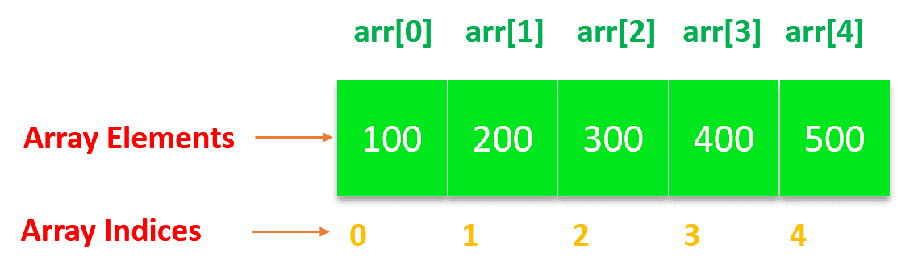
One Dimensional Arrays
One Dimensional Arrays:
Array in C can be defined as a method of clubbing multiple entities of similar type into a larger group.
These entities or elements can be of int, float, char, or double data type or can be of user-defined data types too like structures.
However, in order to be stored together in a single array, all the elements should be of the same data type.
The elements are stored from left to right with the left-most index being the 0th index and the rightmost index being the (n-1) index.
www.myanatomy.in

Slide 55
One Dimensional Arrays
One Dimensional Arrays: Searching an Element
#include<stdio.h>
int main(){
int arr[20], size, key, i, index;
printf("Number of elements in the list: ");
scanf("%d", &size);
printf("Enter elements of the list: ");
for (i = 0; i < size; i++)
scanf("%d", &arr[i]);
printf("Enter the element to search ie. key element: ");
scanf("%d", &key);
for (index = 0; index < size; index++) {
if (arr[index] == key){
printf("Key element found at index %d\n", index);
break;
}
}
printf("Key element not found");
return 0;
}
The Linear Search algorithm in C sequentially checks each element of the list until the key element is found or the entire list has been traversed. Therefore, it is known as a sequential search.
www.myanatomy.in

Slide 56


One Dimensional Arrays
Arrays and Memory in C:
Let us consider the below example for the illustration of arrays and memory.
In the above example, we have declared an array with three elements 4, 6, and 9.
The image below is the visualization of an array that we had so far in our previous example.
Let us assume that an integer occupies four bytes of space, and the first byte of the first element of the array is stored at memory location 50 as shown in the image below.
www.myanatomy.in

Slide 57
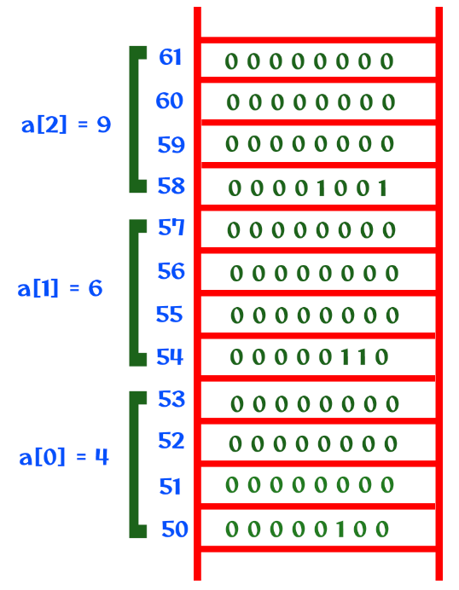
One Dimensional Arrays
Arrays and Memory in C:
From 50 to 54, the first element four will get stored from 55 to 58, the second element six will get stored, and from 59 to 62, the third element nine will get stored.
The clear visualization of the memory is shown in the image below.
www.myanatomy.in

Slide 58
One Dimensional Arrays
Arrays and Memory in C:
Accessing the elements of an array
To access the elements of an array, we use index methods like a[1], a[2] etc. From the above image, whenever a[1] is identified, the compiler will access the bits from memory location 55 and for a[2], the bits from 59 will be accessed.
How will the compiler calculate the address? It is based on the formula given below.
Base address + size of the element * index.
For example, a[1] is used in printf(“%d”, a[1]);.
Address = 50 + 4 * 1.
www.myanatomy.in

Slide 59
One Dimensional Arrays
Pointer with Arrays:
int ma[8] = {10, 20, 30, 40, 50, 60, 70, 80};
0 1 2 3 4 5 6 7
Index
address
ma
100
10 | 20 | 30 | 40 | 50 | 60 | 70 | 80
100 104 108 112 116 120 124 128
ma = ma+1;
// error: incompatible types in assignment of 'int*' to 'int [5]'
int *p;
p = ma + 1;
= 100 + 1*4
= 104
ma[ i ] = *(ma + i*size of data)
ma[ 0 ] = *(ma + 0 * 4) = 100 + 0 = 100 || *100 = 10
ma[ 2 ] = *(ma + 2 * 4) = 100 + 8 = 108 || *108 = 30
www.myanatomy.in

Slide 60
One Dimensional Arrays
Pointer with Array:
#include <stdio.h>
int main()
{
int i, *p;
int ma[5]={20, 30, 40, 50, 60};
p=ma; // or p=&ma[0];
for(i=0; i<5; i++)
{
printf(“%d”, p[ i ]);
}
}
www.myanatomy.in

Slide 61
One Dimensional Arrays
Functions and Arrays: Pasing Base Address of an Array to a Function:
#include <stdio.h>
void display(int *p, int n)
{
int i;
for(i=0; i<n; i++){
printf(“%d”, p[i]);
}
}
int main()
{
int i, *p;
int ma[5]={20, 30, 40, 50, 60};
display(ma, 5);
display(ma+2, 3);
printf("Size of Array: %d”, sizeof(ma));
}
www.myanatomy.in

Slide 62
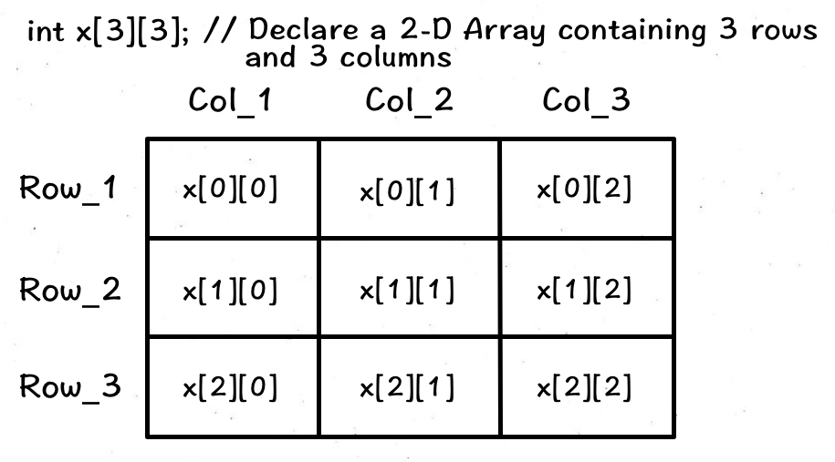
2-D Arrays in C
2-D Array:
In C, we can create an array of an array, known as a multidimensional array.
For example: int x[3][3];
Here, x is a two-dimensional array. It can hold a maximum of 9 elements.
We can think of this array as a table with 3 rows and each row has 3 columns as shown below.
www.myanatomy.in

Slide 63
2-D Arrays in C
2-D Array Initialization:
In C, a 2-D array can be initialized in two ways.
Method-1:
int test[2][3] = {1, 2, 3, 4, 5, 6};
int test[2][3] = {{1, 2, 3}, {4, 5, 6}};
Method-2: using for loop
for(int i=0; i<2; i++)
{
for(int j=0; j<3; j++)
{
scanf(“%d”, &test[i][j];
}
}
1 | 2 | 3
4 | 5 | 6
test
www.myanatomy.in

Slide 64
2-D Arrays in C
Write a C program to insert 9 integers into a 3X3 2-D array and display them
Output:
Enter the elements:
1
2
3
4
5
6
7
8
9
The array elements are:
1 2 3
4 5 6
7 8 9
#include <iostream>
using namespace std;
int main()
{
int test[3][3], i, j;
printf(“Enter the elements:”);
for (i = 0; i < 3; i++)
{
for(j=0; j<3; j++)
{
scanf(“%d”, &test[i][j];
}
}
printf(“The array elements are:”);
for (i = 0; i < 3; i++)
{
for(j=0; j<3; j++)
{
printf(“%d”, test[i][j]);
}
printf(“\n”);
}
return 0;
}
www.myanatomy.in

Slide 65
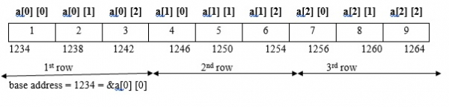
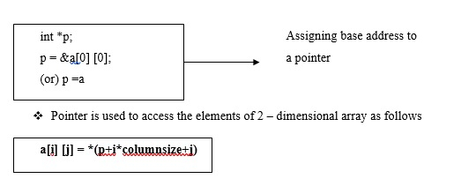
2-D Arrays in C
Pointers and two dimensional arrays
Memory allocation for a two-dimensional array is as follows −
int a[3] [3] = {1,2,3,4,5,6,7,8,9};
a[1] [2] = *(1234 + 1*3+2)
= *(1234 + 3+2)
= *(1234 + 5*4) // 4 is Scale factor
= * (1234+20)
= *(1254)
a[1] [2] = 6
www.myanatomy.in

Slide 66
Strings
C does not have a String type to easily create string variables. Instead, you must use the char type and create an array of characters to make a string in C:
char msg[] = "Hello World!";
Note that you have to use double quotes ("").
To output the string, you can use the printf() function together with the format specifier %s to tell C that we are now working with strings:
Example:
char greetings[] = "Hello World!"; printf("%s", msg);
www.myanatomy.in

Slide 67
Strings
Access Strings
Since strings are actually arrays in C, you can access a string by referring to its index number inside square brackets [].
This example prints the first character (0) in msg:
Example
char msg[] = "Hello World!";
printf("%c", msg[0]);
Note: that we have to use the %c format specifier to print a single character.
www.myanatomy.in

Slide 68
Strings
Modify Strings
To change the value of a specific character in a string, refer to the index number, and use single quotes:
Example
#include <stdio.h>
int main()
{
char greetings[] = "Hello World!";
greetings[0] = 'J';
printf("%s", greetings);
return 0;
}
Loop Through a String
You can also loop through the characters of a string, using a for loop:
Example
#include <stdio.h>
int main()
{
char carName[] = "Volvo";
int i;
for(i = 0; i < 5; ++i)
{
printf("%c\n", carName[i]);
}
return 0;
}
www.myanatomy.in

Slide 69
Strings
Strings and Pointers:
Creating a pointer for the string:
The variable name of the string str holds the address of the first element of the array i.e., it points at the starting memory address.
So, we can create a character pointer ptr and store the address of the string str variable in it. This way, ptr will point at the string str.
In the following code we are assigning the address of the string str to the pointer ptr.
char *ptr = str;
www.myanatomy.in

Slide 70
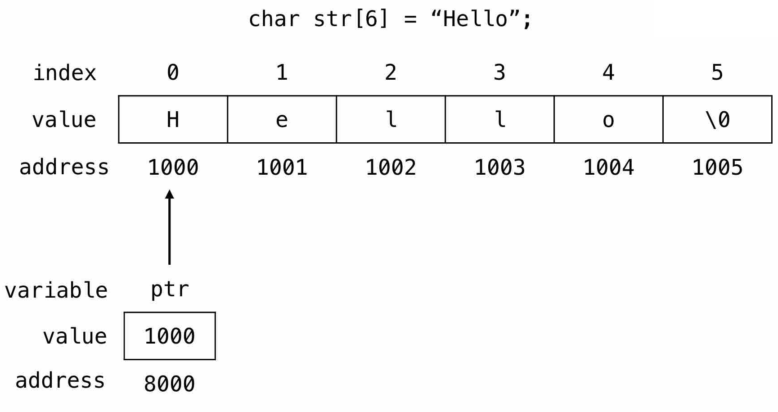
Strings
Strings and Pointers:
We can represent the character pointer variable ptr as follows.
The pointer variable ptr is allocated memory address 8000 and it holds the address of the string variable str i.e., 1000.
www.myanatomy.in

Slide 71
Strings
Strings and Pointers:
#include <stdio.h>
int main(void)
{
char str[6] = "Hello";
char *ptr = str;
while(*ptr != '\0')
{
printf("%c", *ptr);
// move the ptr pointer to the next memory location
ptr++;
}
return 0;
}
Accessing string via pointer:
To access and print the elements of the string we can use a loop and check for the \0 null character.
In the following example we are using while loop to print the characters of the string variable str.
www.myanatomy.in

Slide 72
Strings
String Functions:
We're often required to modify the strings and perform several operations on them according to our needs. If we want to get the length of the string, we could run a loop and calculate its length, but it is not the best way in case of complex problems. Hence, string functions are used to make our code efficient and straightforward as they are pre-written so we can use them directly.
The string handling functions are defined in the header file string.h. This header file must be included in the C program to use the string handling functions.
www.myanatomy.in

Slide 73
Strings
String Functions: The following are the string functions in C:
Function | Description
strlen() | It returns the string's length.
strnlen() | It returns the specified value if the value specified is less than the string length, otherwise the string length.
strcmp() | It compares two strings and returns 0 if the strings are the same.
strncmp() | It compares two strings only to n characters.
strcat() | It concatenates two strings and returns the concatenated string.
strncat() | It concatenates n characters of one string to another string.
strcpy() | It copies one string into another.
www.myanatomy.in

Slide 74
Recursion in C
Recursion is a method in C which calls itself directly or indirectly until a suitable condition is met.
In this method, we repeatedly call the function within the same function, and it has a base case and a recursive condition. The recursive condition helps in the repetition of code again and again, and the base case helps in the termination of the condition.
If there is no base case in the recursive function, the recursive function will continue to repeat continuously.
Here, n==0 is the base case that will terminate the iteration of function when n becomes equal to zero.
Return recursion(n-1) is the recursive function that will help in the repetition of code.
int recursion(n)
{
if(n == 0)
{
return 0;
}
return recursion(n-1);
}
www.myanatomy.in

Slide 75
Recursion in C
Program to demonstrate recursion-1: Calculate factorial using recursion
#include <stdio.h>
int fact(int n)
{
if(n>=1)
return n*fact(n-1);
else
return 1;
}
int main()
{
int num, f;
printf("Enter a positive integer: “);
scanf(“%d”, &num);
f = fact(num);
printf("Factorial of %d is : %d“, num, f);
return 0;
}
www.myanatomy.in

Slide 76
Recursion in C
Program to demonstrate recursion-2: Prime check using recursion
int main()
{
int num, b;
printf("Enter a positive integer:”);
scanf(“%d”,&num);
b = checkPrime(num, num/2);
if(b == 1)
{
printf(“%d is a Prime number !”, num);
}
else
{
printf(“%d is not a Prime number!“, num);
}
return 0;
}
#include <stdio.h>
int checkPrime(int n, int index)
{
if(index == 1){
return 1;
}
else if(n % index == 0){
return 0;
}
else
return checkPrime(n, index-1);
}
www.myanatomy.in

Slide 77
Structures and Unions
Structure is a user-defined datatype in C language which allows us to combine data of different types together. Structure helps to construct a complex data type which is more meaningful. It is somewhat similar to an Array, but an array holds data of similar type only. But structure on the other hand, can store data of any type, which is practical more useful.
For example: If I have to write a program to store Student information, which will have Student's name, age, branch, permanent address, father's name etc, which included string values, integer values etc, how can I use arrays for this problem, I will require something which can hold data of different types together.
www.myanatomy.in

Slide 78
Structures and Unions
Defining a structure:
struct keyword is used to define a structure. struct defines a new data type which is a collection of primary and derived data types.
Syntax:
struct [structure_tag]
{
//member variable 1
//member variable 2
...
}[structure_variables];
As you can see in the syntax above, we start with the struct keyword, then it's optional to provide your structure a name, we suggest you to give it a name, then inside the curly braces, we have to mention all the member variables, which are nothing but normal C language variables of different types like int, float, array etc.
After the closing curly brace, we can specify one or more structure variables, again this is optional.
Note: The closing curly brace in the structure type declaration must be followed by a semicolon(;).
www.myanatomy.in

Slide 79
Structures and Unions
Example of Structure:
struct Student
{
char name[25];
int age;
char branch[10];
char gender;
};
Here struct Student declares a structure to hold the details of a student which consists of 4 data fields, namely name, age, branch and gender. These fields are called structure elements or members.
Each member can have different datatype, like in this case, name is an array of char type and age is of int type etc. Student is the name of the structure and is called as the structure tag.
www.myanatomy.in

Slide 80
Structures and Unions
Declaring Structure Variables:
It is possible to declare variables of a structure, either along with structure definition or after the structure is defined. Structure variable declaration is similar to the declaration of any normal variable of any other datatype. Structure variables can be declared in following two ways:
struct Student
{
char name[25];
int age;
char branch[10];
char gender;
};
struct Student S1, S2; //declaring variables of struct Student
struct Student
{
char name[25];
int age;
char branch[10];
char gender;
}S1, S2;
www.myanatomy.in

Slide 81
Structures and Unions
Accessing Structure Members:
Structure members can be accessed and assigned values in a number of ways. Structure members have no meaning individually without the structure. In order to assign a value to any structure member, the member name must be linked with the structure variable using a dot . operator also called period or member access operator.
#include<stdio.h>
#include<string.h>
struct Student
{
char name[25];
int age;
char branch[10];
char gender;
};
int main()
{
struct Student s1;
s1.age = 18;
strcpy(s1.name, "Viraaj");
printf("Name of Student 1: %s\n", s1.name);
printf("Age of Student 1: %d\n", s1.age);
return 0;
}
www.myanatomy.in

Slide 82
Structures and Unions
Structure Initialization:
Like a variable of any other datatype, structure variable can also be initialized at compile time.
//initialization
struct Patient
{
float height;
int weight;
int age;
};
struct Patient p1 = { 180.75 , 73, 23 };
//initialization of each member separately
struct Patient p1;
p1.height = 180.75;
p1.weight = 73;
p1.age = 23;
www.myanatomy.in

Slide 83
Structures and Unions
Array of Structure:
We can also declare an array of structure variables. in which each element of the array will represent a structure variable. Example : struct employee emp[5];
The below program defines an array emp of size 5. Each element of the array emp is of type Employee.
#include<stdio.h>
struct Employee
{
char ename[10];
int sal;
};
struct Employee emp[5];
int i, j;
void ask()
{
for(i = 0; i < 3; i++)
{
printf("\nEnter %d Employee record:\n", i+1);
printf("\nEmployee name:\t");
scanf("%s", emp[i].ename);
printf("\nEnter Salary:\t");
scanf("%d", &emp[i].sal);
}
printf("\nDisplaying Employee record:\n");
for(i = 0; i < 3; i++)
{
printf("\nEmployee name is %s", emp[i].ename);
printf("\nSlary is %d", emp[i].sal);
}
}
void main()
{
ask();
}
www.myanatomy.in

Slide 84
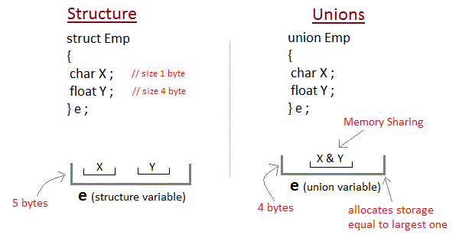
Structures and Unions
Unions:
Unions are conceptually similar to structures in C. The syntax to declare/define a union is also similar to that of a structure. The only differences is in terms of storage.
In structure each member has its own storage location, whereas all members of union uses a single shared memory location which is equal to the size of its largest data member.
This implies that although a union may contain many members of different types, it cannot handle all the members at the same time.This implies that although a union may contain many members of different types, it cannot handle all the members at the same time.
www.myanatomy.in

Slide 85
Structures and Unions
Declaring a Union in C:
A union is declared using the union keyword in C. The syntax is as follows
union tag_name {
member definition;
member definition;
...
member definition;
} union variable(s);
For example,
union item
{
int m;
float x;
char c;
} It1;
This declares a variable It1 of type union item. This union contains three members each with a different data type. However only one of them can be used at a time. This is due to the fact that only one location is allocated for all the union variables, irrespective of their size. The compiler allocates the storage that is large enough to hold the largest variable type in the union.
In the union declared above the member x requires 4 bytes which is largest amongst the members for a 16-bit machine. Other members of union will share the same memory address.
To define variables of a union, we use union keyword as follows:
union item it2, it3;
www.myanatomy.in

Slide 86
Structures and Unions
Accessing a Union Member in C:
We use member access operator (.) to access members of a union in C. It is used between the union variable name and the union member that we want to access. Syntax for accessing any union member is similar to accessing structure members.
union test
{
int a;
float b;
char c;
}t;
t.a; //to access members of union t
t.b;
t.c;
In unions, if we change the value of any one member, the value of other members gets affected.
www.myanatomy.in

Slide 87
File Handling
What is File Handling in C?
File handling refers to the method of storing data in the C program in the form of an output or input that might have been generated while running a C program in a data file, i.e., a binary file or a text file for future analysis and reference in that very program.
What is a File in C?
A file refers to a source in which a program stores the information/data in the form of bytes of sequence on a disk (permanently). The content available on a file isn’t volatile like the compiler memory in C. But the program can perform various operations, such as creating, opening, reading a file, or even manipulating the data present inside the file. This process is known as file handling in C.
Why Do We Need File Handling in C?
There are times when the output generated out of a program after its compilation and running do not serve our intended purpose. In such cases, we might want to check the program’s output various times. Now, compiling and running the very same program multiple times becomes a tedious task for any programmer. It is exactly where file handling becomes useful.
www.myanatomy.in

Slide 88
File Handling
Let us look at a few reasons why file handling makes programming easier for all:
Reusability: File handling allows us to preserve the information/data generated after we run the program.
Saves Time: Some programs might require a large amount of input from their users. In such cases, file handling allows you to easily access a part of a code using individual commands.
Commendable storage capacity: When storing data in files, you can leave behind the worry of storing all the info in bulk in any program.
Portability: The contents available in any file can be transferred to another one without any data loss in the computer system. This saves a lot of effort and minimizes the risk of flawed coding.
www.myanatomy.in

Slide 89
File Handling
Types of Files in a C Program
When referring to file handling, we refer to files in the form of data files. Now, these data files are available in 2 distinct forms in the C language, namely:
Text Files
Binary Files
Text Files
The text files are the most basic/simplest types of files that a user can create in a C program. We create the text files using an extension .txt with the help of a simple text editor. In general, we can use notepads for the creation of .txt files. These files store info internally in ASCII character format, but when we open these files, the content/text opens in a human-readable form.
Text files are, thus, very easy to access as well as use. But there’s one major disadvantage; it lacks security. Since a .txt file can be accessed easily, information isn’t very secure in it. Added to this, text files consume a very large space in storage.
To solve these problems, we have a different type of file in C programs, known as binary files.
www.myanatomy.in

Slide 90
File Handling
Binary Files
The binary files store info and data in the binary format of 0’s and 1’s (the binary number system). Thus, the files occupy comparatively lesser space in the storage. In simpler words, the binary files store data and info the same way a computer holds the info in its memory. Thus, it can be accessed very easily as compared to a text file.
The binary files are created with the extension .bin in a program, and it overcomes the drawback of the text files in a program since humans can’t read it; only machines can. Thus, the information becomes much more secure. Thus, binary files are safest in terms of storing data files in a C program.
Operators/Functions that We Use for File Handling in C
We can use a variety of functions in order to open a file, read it, write more data, create a new file, close or delete a file, search for a file, etc. These are known as file handling operators in C.
www.myanatomy.in

Slide 91
File Handling
Here’s a list of functions that allow you to do so: Here’s a list of functions that allow you to do so:
Description of Function | Function in Use
used to open an existing file or a new file | fopen()
writing data into an available file | fprintf()
reading the data available in a file | fscanf()
writing any character into the program file | fputc()
reading the character from an available file | fgetc()
used to close the program file | fclose()
used to set the file pointer to the intended file position | fseek()
writing an integer into an available file | fputw()
used to read an integer from the given file | fgetw()
used for reading the current position of a file | ftell()
sets an intended file pointer to the file’s beginning itself | rewind()
www.myanatomy.in

Slide 92
File Handling
Operations Done in File Handling
The process of file handling enables a user to update, create, open, read, write, and ultimately delete the file/content in the file that exists on the C program’s local file system. Here are the primary operations that you can perform on a file in a C program:
Opening a file that already exists
Creating a new file
Reading content/ data from the existing file
Writing more data into the file
Deleting the data in the file or the file altogether
www.myanatomy.in

Slide 93
File Handling
Opening a File in the Program – to create and edit data
We open a file with the help of the fopen() function that is defined in the header file- stdio.h.
Here is the syntax that we follow when opening a file:
ptr = fopen (“openfile” , “openingmode”);
Let us take a look at an example for the same,
fopen (“E:\\myprogram\\recentprogram.txt” , “w”);
fopen (“E:\\myprogram\\previousprogram.bin” , “rb”);
www.myanatomy.in

Slide 94
File Handling
Opening a File in the Program – to create and edit data
Here, if we suppose that the file – recentprogram.txt doesn’t really exist in the E:\\myprogram location. Here, we have used the mode “w”. Thus, the first function will create a new file with the name recentprogram.txt and then open it for writing (since we have used the “w” mode).
The “w” here refers to writing mode. It allows a programmer to overwrite/edit and create the contents in a program file.
Now, let us take a look at the second binary previous program.bin file that is present in the E:\\myprogram location. Thus, the second function here will open the file (that already exists) for reading in the “rb” binary mode.
The “rb” refers to the reading mode. It only allows you to read a file, but not overwrite it. Thus, it will only read this available file in the program.
www.myanatomy.in

Slide 95
File Handling
Let us take a look at a few more opening modes used in the C programs:
Opening Modes of C in Standard I/O of a Program
Mode in Program | Meaning of Mode | When the file doesn’t exist
r | Open a file for reading the content. | In case the file doesn’t exist in the location, then fopen() will return NULL.
rb | Open a file for reading the content in binary mode. | In case the file doesn’t exist in the location, then fopen() will return NULL.
w | Open a file for writing the content. | In case the file exists, its contents are overwritten. In case the file doesn’t exist in the location, then it will create a new file.
www.myanatomy.in

Slide 96
File Handling
How do we close a file?
Once we write/read a file in a program, we need to close it (for both binary and text files). To close a file, we utilise the fclose() function in a program.
Here is how the program would look like:
fclose(fptr);
In this case, the fptr refers to the file pointer that is associated with that file that needs to be closed in a program.
How do we read and write the data to the text file?
We utilise the fscanf() and fprintf() to write and read the data to the text file. These are basically the file versions of the scanf() and printf(). But there is a major difference, i.e., both fscanf() and fprintf() expect a pointer pointing towards the structure FILE in the program.
www.myanatomy.in

Slide 97
File Handling
Example #1: Writing Data to the Text File in a Program
#include <stdio.h>
#include <stdlib.h>
int main()
{
int val;
FILE *fptr;
fptr = fopen (“C:\\currentprogram.txt”,”w”);
if(fptr == NULL)
{
printf(“File type invalid!”);
exit(1);
}
printf(“Please enter the val: “);
scanf(“%d”,&val);
fprintf(fptr,”%d”,val);
fclose(fptr);
return 0;
}
www.myanatomy.in

Slide 98
File Handling
Example #2: Reading Information from the Text File in a Program
#include <stdio.h>
#include <stdlib.h>
int main()
{
int val;
FILE *fptr;
if ((fptr = fopen(“C:\\currentprogram.txt”,”r”)) == NULL)
{
printf(“Visible error detected. Cannot open the file!”);
exit(1);
}
fscanf(fptr,”%d”, &val);
printf(“The value of the integer n is=%d”, val);
fclose(fptr);
return 0;
}
www.myanatomy.in

Slide 99
Thank You
www.myanatomy.in

